Slide 1
Chapter 5
Hashing
Hashing is a technique used for insertions, deletions, and finds in constant time.
In this chapter we:
Examine several methods for implementing hash tables
Compare theses hashing methods
Examine applications for hashing
Compare hash tables with binary search trees
Nov 2, 2011 | CECS 302. Instructor: I Imam

Slide 2
The Hash Tables
Recall that we usually have data values associated with a search key, such as SSN as a search key associated with data in an employees record.
A hash table is an array of some fixed size (call it tableSize) that allow us to insert, delete and find records by mapping the key into an index value between 0 and tableSize -1
The mapping function that maps the key into the index is called a hash function.
Hash functions should be simple and ideally should map two distinct keys to two different cells (indices).
In real life we have more keys than cells. Therefore; invariably we have two keys map to the same index. This is called a collision
Nov 2, 2011 | CECS 302. Instructor: I Imam

Slide 3





Some Simple Idea
Examine what happens if table size is 10 and key values all ended with 0
Examine what happens if table size is a prime number (e.g. 11)
Nov 2, 2011 | CECS 302. Instructor: I Imam

Slide 4
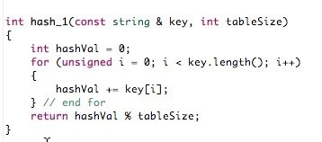
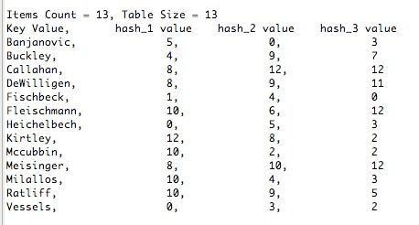
Hash Function Example
Nov 2, 2011 | CECS 302. Instructor: I Imam

Slide 5

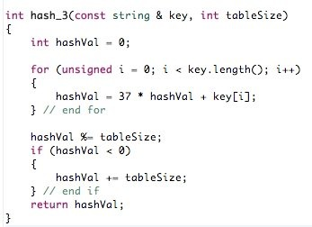
More Hash Functions
Nov 2, 2011 | CECS 302. Instructor: I Imam

Slide 6
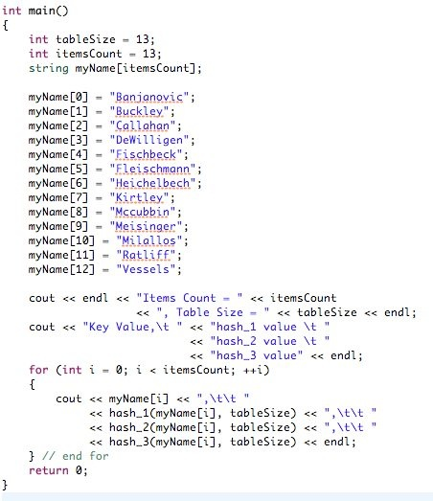
The main()
Nov 2, 2011 | CECS 302. Instructor: I Imam

Slide 7
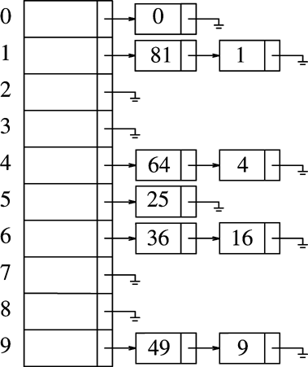
Collision Resolution Strategies
Separate Chaining: Keep a list of all elements that hash to the same value
Example:
Consider the first 10 perfect squares 0, 1, 4, 9, 16, 25, 36, 49, 64, 81
Let the hash function be hash(x) = x mod 10
Notice that 1 and 81 hash to 1.
1 is inserted in the list first. When 81 is inserted a new node (node 1) is allocated to store the 81 and it is also set to point to node 0 that contains 1.
n | x | hash(x)
0 | 0 | 0
1 | 1 | 1
2 | 4 | 4
3 | 9 | 9
4 | 16 | 6
5 | 25 | 5
6 | 36 | 6
7 | 49 | 9
8 | 64 | 4
9 | 81 | 1
Table Cell | Content | Linked List node 1 | Linked List node 0
0 | 0 |  | 0
1 | 1, 81 | 81 | 1
2 | empty
3 | empty
4 | 4, 64 | 64 | 4
5 | 25 |  | 25
6 | 16, 36 | 36 | 16
7 | empty
8 | empty
9 | 9, 81 | 81 | 9
Nov 2, 2011 | CECS 302. Instructor: I Imam

Slide 8
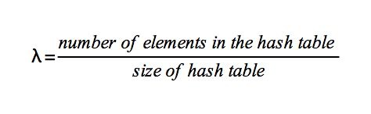
Collision Resolution Strategies (cont.)
The load factor λ is a measure of how full our table is and is defined by the ration of the number of elements in the hash table to the size of the hash table.
For the previous example λ is 1.
The closer λ to 1 the greater the chance for collisions
To avoid collisions
Use a large table,
Use Linked Lists ( This is the Separate Chaining)
Use a one-to-one hashing function (In a perfect world)
Nov 2, 2011 | CECS 302. Instructor: I Imam

Slide 9
Hash Tables Without Linked Lists
Linked Lists may slow performance due to overhead in allocating and inserting in the new node.
We will use techniques that will not allocate new node but will try to use another cell in the hash table.
For these we have hi(x) = hash(x) + f(i) where f(i) is the adjustment to find the new empty cell.
To locate a new empty cell in the hash table we use one of two techniques:
Probing
Linear Probing, f(i) is linear e.g. f(i) = i
Quadratic Probing, f(i) is quadratic, e.g. f(i) = i²
Double hashing where f(i) is a second hash function such as
f(i) = i*hash2(x)
Nov 2, 2011 | CECS 302. Instructor: I Imam

Slide 10
Example of Linear Probing
Let us insert {89, 18, 49, 58, 69} in our hash table of 10 numbered cells 0, ..., 9
Let the hash function be hash(x) = x mod 10
Use linear probing with f(i) = i
 |  | inserts
Table Cell | empty | 89 | 18 | 49 | 58 | 69
0 |  |  |  | 49 | 49 | 49
1 |  |  |  |  | 58 | 58
2 |  |  |  |  |  | 69
3
4
5
6
7
8 |  |  | 18 | 18 | 18 | 18
9 |  | 89 | 89 | 89 | 89 | 89
x | hash(x) | Collision | hash(x) + 1 | hash(x) + 2 | hash(x) + 3
89 | 9 | no
18 | 8 | no
49 | 9 | yes | (9+1)mod10 = 0
58 | 8 | yes | (8+1)mod10 = 9 | (8+2)mod10 = 0 | (8+3)mod10 = 1
69 | 9 | yes | (9+1)mod10 = 0 | (9+2)mod10 = 1 | (9+3)mod10 = 2
Nov 2, 2011 | CECS 302. Instructor: I Imam

Slide 11
Rehashing
If the hash table becomes too full, It will start taking too long to insert a new element.
Some collision avoidance techniques may also start failing
To solve this problem we rehash the entire sequence again
Since hashing is of constant order we will not notice performance degradation
We should use the next prime number to twice the current size of our hash table. (keep λ ≈ 0.5 and keep size prime)
Nov 2, 2011 | CECS 302. Instructor: I Imam

Slide 12
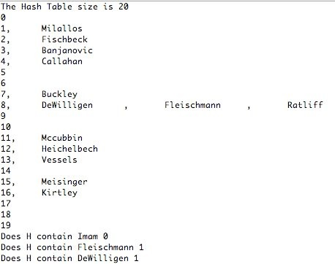
Size is big enough, no need to rehash
Nov 2, 2011 | CECS 302. Instructor: I Imam

Slide 13
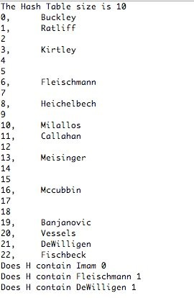
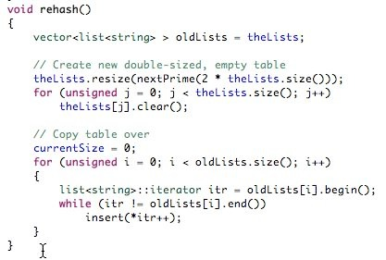
Table too small, We must rehash
Nov 2, 2011 | CECS 302. Instructor: I Imam

Slide 14
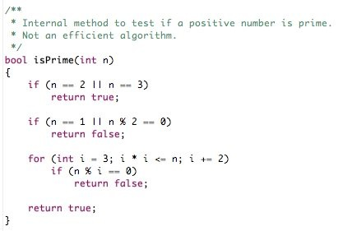
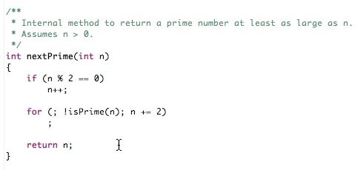
Needed Functions
Nov 2, 2011 | CECS 302. Instructor: I Imam

